Slide 1
Data Science & Big Data Analytics Unit-I
Dr. G. Paavai Anand

Slide 2

Data Analytics
Data is extracted and categorized to identify and analyze behavioral data and patterns, and techniques vary according to organizational requirements.
Eg. 1 – Prediction in the game of Cricket
Eg. 2 – Prediction of your exam score

Slide 3
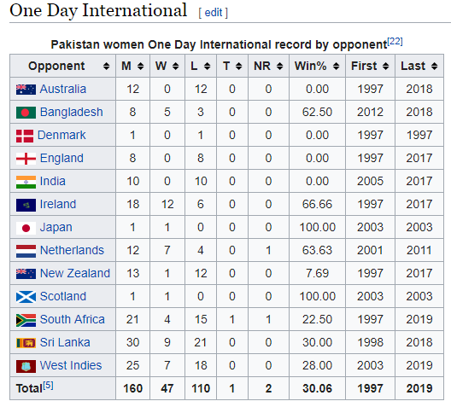

Slide 4
Types of Analytics
Descriptive: A set of techniques for reviewing and examining the data set(s) to understand the data and analyze business performance.
Diagnostic: A set of techniques for determine what has happened and why
Predictive: A set of techniques that analyze current and historical data to determine what is most likely to (not) happen
Prescriptive: A set of techniques for computationally developing and analyzing alternatives that can become courses of action – either tactical or strategic – that may discover the unexpected
Decisive: A set of techniques for visualizing information and recommending courses of action to facilitate human decision-making when presented with a set of alternatives.

Slide 5
Introduction to big data

Slide 6

What is Big data?
Big Data is the amount of data just beyond technology’s capability to store, manage and process efficiently.

Slide 7
Big Data is data whole scale, diverse and complex - requires new architecture, techniques, algorithms and analytics to manage it and extract value and hidden knowledge from it…

Slide 8

Trends leading to Data Flood
More data is generated:
Bank, telecom, other business transactions ...
Scientific data: astronomy, biology, etc
Web, text, and e-commerce

Slide 9
Big Data Examples
Europe's Very Long Baseline Interferometry (VLBI) has 16 telescopes, each of which produces 1 Gigabit/second of astronomical data over a 25-day observation session
storage and analysis a big problem
AT&T handles billions of calls per day
so much data, it cannot be all stored -- analysis has to be done “on the fly”, on streaming data

Slide 10
Largest databases in 2003
Commercial databases:
Winter Corp. 2003 Survey: France Telecom has largest decision-support DB, ~30TB; AT&T ~ 26 TB
Web
Alexa internet archive: 7 years of data, 500 TB
Google searches 4+ Billion pages, many hundreds TB
IBM WebFountain, 160 TB (2003)
Internet Archive (www.archive.org),~ 300 TB

Slide 11
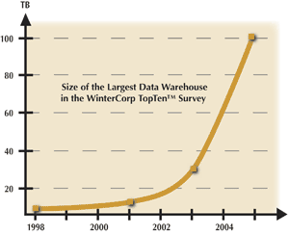
Data Growth
In 2 years, the size of the largest database TRIPLED!

Slide 12
Data Growth Rate
Twice as much information was created in 2002 as in 1999 (~30% growth rate)
Other growth rate estimates even higher
Very little data will ever be looked at by a human
Knowledge Discovery is NEEDED to make sense and use of data.

Slide 13
Big data characteristics

Slide 14
Big Data
Big Data is any data that is expensive to manage and hard to extract value from
Volume
The size of the data
Velocity
The latency of data processing relative to the growing demand for interactivity
Variety and Complexity
the diversity of sources, formats, quality, structures.

Slide 15
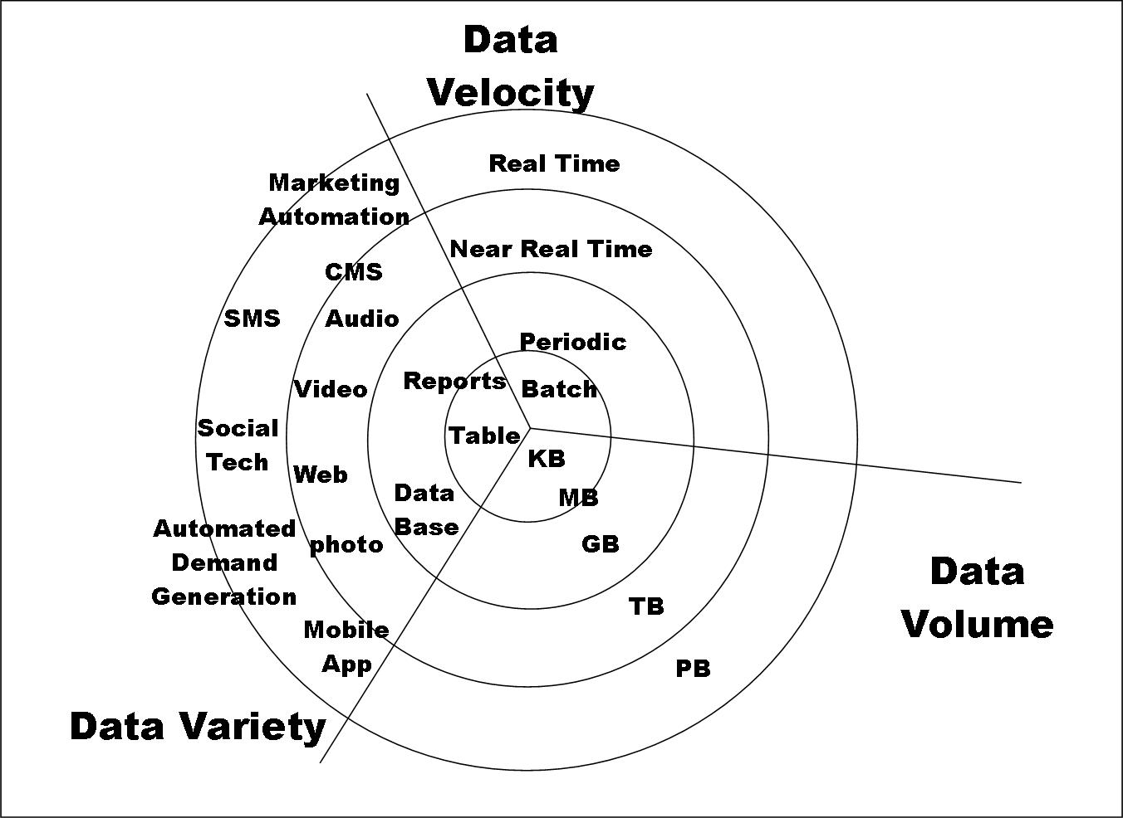
Big Data

Slide 16
Characteristics - Some Big Data Issues Affecting Analytics
Volume:
How much data is really relevant to the problem solution? Cost of processing?
So, can you really afford to store and process all that data?
Velocity:
Much data coming in at high speed
Need for streaming versus block approach to data analysis
So, how to analyze data in-flight and combine with data at-rest
Variety:
A small fraction is structured formats, Relational, XML, etc.
A fair amount is semi-structured, as web logs, etc.
The rest of the data is unstructured text, photographs, etc.
So, no single data model can currently handle the diversity
Veracity:
Accuracy, Precision, Reliability, Integrity (Trustworthiness of data)
So, what is it that you don’t know you don’t know about the data?
Value:
How much value is created for each unit of data (whatever it is)?
So, what is the contribution of subsets of the data to the problem solution?

Slide 17
R – Introduction

Slide 18
# import a csv file of the total annual sales for each customer
sales <- read.csv("C:/Users/A/Desktop/yearly_sales.csv")
# examine the imported dataset
head(sales)
cust_id sales_total num_of_orders gender
100001 800.64 3 F
100002 217.53 3 F
100003 74.58 2 M
100004 498.60 3 M
100005 723.11 4 F
100006 69.43 2 F

Slide 19
summary(sales)
cust_id sales_total num_of_orders gender
Min. :100001 Min. : 30.02 Min. : 1.000 F:5035
1stQu.:102501 1st Qu.: 80.29 1st Qu.: 2.000 M:4965
Median :105001 Median : 151.65 Median : 2.000
Mean :105001 Mean : 249.46 Mean : 2.428
3rdQu.:107500 3rd Qu.: 295.50 3rd Qu.: 3.000
Max. :110000 Max. :7606.09 Max. :22.000

Slide 20
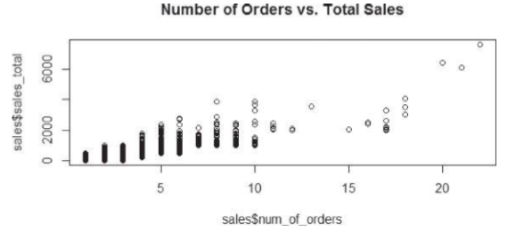
plot(sales$num_of_orders,sales$sales_total,
main="Number of Orders vs. Sales")

Slide 21
results <- lm(sales$sales_total ~ sales$num_of_orders)
results
Call: lm(formula = sales$sales_total ˜ sales$num_of_orders)
Coefficients:
(Intercept) sales$num_of_orders -154.1 166.2

Slide 22
summary(results)
Call: lm(formula = sales$sales_total ˜ sales$num_of_orders)
Residuals:
Min 1Q Median 3Q Max
-666.5 -125.5 -26.7 86.6 4103.4
Coefficients:
Estimate Std. Error t value Pr(>|t|)
(Intercept) -154.128 4.129 -37.33 <2e-16
***
sales$num_of_orders 166.221 1.462 113.66 <2e-16 *** –
Signif. codes: 0 ‘***’ 0.001 ‘**’ 0.01 ‘*’ 0.05 ‘.’ 0.1 ‘ ‘ 1
Residual standard error: 210.8 on 9998 degrees of freedom Multiple R-squared: 0.5637,
Adjusted R-squared: 0.5637
F-statistic: 1.292e+04 on 1 and 9998 DF,
p-value: < 2.2e-16

Slide 23
Generic function
The summary() function is an example of a generic function.
A generic function is a group of functions sharing the same name but behaving differently depending on the number and the type of arguments they receive.
Plot() and hist() are other generic functions

Slide 24
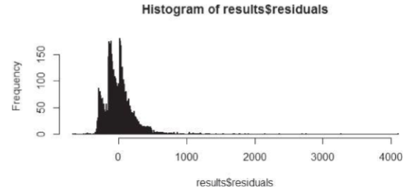
hist(results$residuals, breaks = 800)

Slide 25
R graphical user interfaces

Slide 26
R software uses a command-line interface (CLI) that is similar to the BASH shell in Linux or the interactive versions of scripting languages such as Python.
UNIX and Linux users can enter command R at the terminal prompt to use the CLI.
For Windows installations, R comes with RGui.exe, which provides a basic graphical user interface (GUI).
However, to improve the ease of writing, executing, and debugging R code, several additional GUIs have been written for R.
Popular GUIs include the R commander [3], Rattle [4], and RStudio [5].

Slide 27
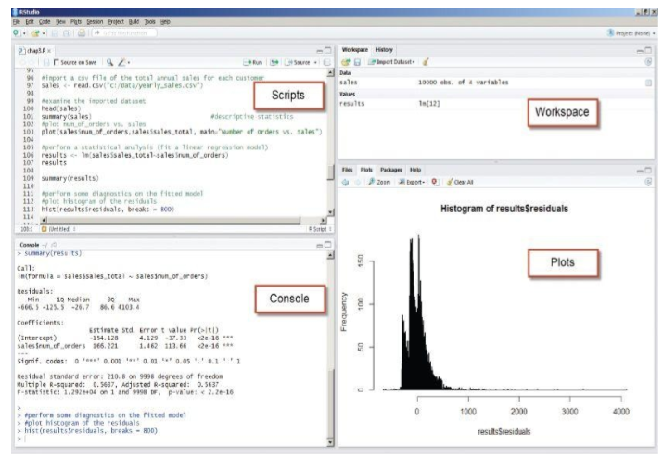

Slide 28
The four highlighted window panes follow.
Scripts: Serves as an area to write and save R code
Workspace: Lists the datasets and variables in the R environment
Plots: Displays the plots generated by the R code and provides a straightforward mechanism to export the plots
Console: Provides a history of the executed R code and the output
edit() and fix() functions to allow the user to update the contents of an R variable.
In Rstudio, we can select the variables from the workspace pane and do the same.
R saves the workspace environment into .Rdata file using the save.image() function.
Load.image() function allows us to load the previously saved workspace.

Slide 29
Data Import and Export

Slide 30
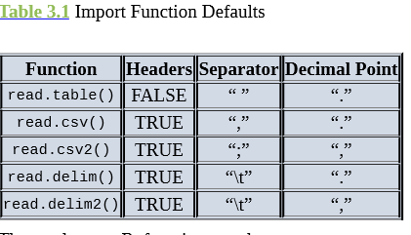
sales <- read.csv(“c:/data/yearly_sales.csv”)
setwd(“c:/data/”)
sales <- read.csv(“yearly_sales.csv”)
sales_table<-read.table(“yearly_sales.csv”, header=TRUE, sep=”,”)
Sale
s_delim <- read.delim(“yearly_sales.csv”, sep=”,”)

Slide 31
The analogous R functions such as write.table(), write.csv(), and write.csv2()
# add a column for the average sales per order
sales$per_order<-sales$sales_total/sales$num_of_orders
# export data as tab delimited without the row names
write.table(sales,“C:/Users/A/Desktop/sales_modified.txt”, sep=”\t”, row.names=FALSE

Slide 32
Database connectivity – need to install ROBDC package before executing these commands
install.packages(“RODBC”)
library(RODBC)
conn <- odbcConnect(“training2”, uid=“user”, pwd=“password”)
housing_data <- sqlQuery(conn, “select serialno, state, persons, rooms from housing where hinc > 1000000”)
head(housing_data)

Slide 33
Convert the histogram to JPEG file
jpeg(file=“c:/data/sales_hist.jpeg”)
# create a new jpeg file hist(sales$num_of_orders)
# export histogram to jpeg
dev.off()
# shut off the graphic device

Slide 34
Attribute and Data Types

Slide 35
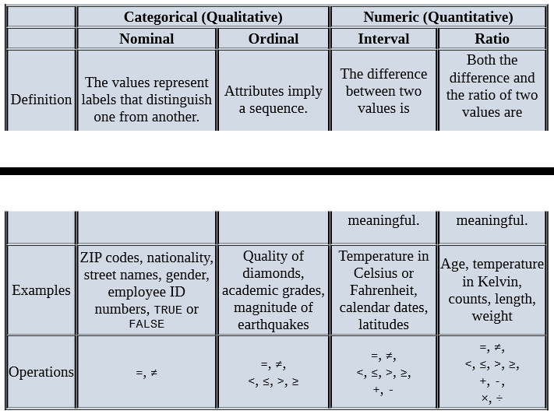

Slide 36
Numeric, Character, and Logical Data Types
i <- 1
# create a numeric variable
sport <- “football”
# create a character variable
flag <- TRUE
# create a logical variable
class(i) # returns “numeric”
typeof(i) # returns “double”
class(sport) # returns “character”
typeof(sport) # returns “character”
class(flag) # returns “logical”
typeof(flag) # returns “logical”
is.integer(i) # returns FALSE
j<-as.integer(i) # coerces contents of I into an integer
is.integer(j) # returns TRUE
length(i) # returns 1
length(flag) # returns 1
length(sport) # returns 1(not 8 for “football”)
-----because these are single entities called vectors

Slide 37
Vectors
Vectors are a basic building block for data in R.
As seen previously, simple R variables are actually vectors.
A vector can only consist of values in the same class.

Slide 38
Vectors
is.vector(i) # returns TRUE
is.vector(flag) # returns TRUE
is.vector(sport) # returns TRUE
u <- c(“red”, “yellow”, “blue”)
# create a vector “red” “yellow” “blue”
u
# returns “red” “yellow” “blue”
u[1]
# returns “red” (1st element in u)
v <- 1:5
# create a vector 1 2 3 4 5
v
# returns 1 2 3 4 5
sum(v)
# returns 15
w<-v*2
# create a vector 2 4 6 8 10
w
# returns 2 4 6 8 10

Slide 39
w[3]
#returns 6 (the 3rd element of w)
z<-v+w
#sums two vectors element by element
z
#returns 3 6 9 12 15
z>8
#returns FALSE FALSE TRUE TRUE TRUE
z[z>8]
#returns 9 12 15
z[z>8 | z < 5]
#returns 3 9 12 15 (“|” denotes “or”)

Slide 40
a<-vector(length=3)
#create a logical vector of length 3
a
#returns FALSE FALSE FALSE
b<-vector(mode=“numeric”, 3)
#create a numeric vector of length 3
typeof(b)
#returns “double”
b[2]<-3.1
#assign 3.1 to the 2nd element
b
#returns 0.0 3.1 0.0
c<-vector(mode=“integer”, 0)
#create an integer vector of length 0
c
#returns integer(0)
length(c)
#returns 0
length(b) # returns 3
dim(b) # returns NULL (an undefined value)

Slide 41
Arrays and Matrices A two-dimensional array is known as a matrix.
# the dimensions are 3 regions, 4 quarters, and 2 years
quarterly_sales<-array(0, dim=c(3,4,2))
quarterly_sales[2,1,1]<-158000
quarterly_sales
, ,
[,1] [,2] [,3] [,4]
[1,] 0 0 0 0
[2,] 158000 0 0 0
[3,] 0 0 0 0
, , 2
[,1] [,2] [,3] [,4]
[1,] 0 0 0 0
[2,] 0 0 0 0
[3,] 0 0 0 0
# A two-dimensional array is known as a matrix.

Slide 42
sales_matrix<-matrix(0,nrow=3, ncol= 4)
sales_matrix
[,1] [,2] [,3] [,4]
[1,] 0 0 0 0
[2,] 0 0 0 0
[3,] 0 0 0 0

Slide 43
Data Frames - Similar to the concept of matrices, data frames provide a structure for storing and accessing several variables of possibly different data types.
#import a CSV file of the total annual sales for each customer
sales<-read.csv(“c:/data/yearly_sales.csv”)
is.data.frame(sales) # returns TRUE
length(sales$num_of_orders) #returns 10000 (number of customers)
is.vector(sales$cust_id) # returns TRUE is.vector(sales$sales_total) # returns TRUE is.vector(sales$num_of_orders) # returns TRUE is.vector(sales$gender) # returns FALSE is.factor(sales$gender) # returns TRUE

Slide 44
str(sales)
# display structure of the data frame object
‘data.frame’: 10000 obs. of 4 variables:
$cust_id : int 100001 100002 100003 100004 100005 100006 …
$sales_total : num 800.6 217.5 74.6 498.6 723.1 …
$num_of_orders : int 3 3 2 3 4 2 2 2 2 2 …
$gender : Factor w/ 2 levels “F”,“M”: 1 1 2 2 1 1 2 2 1 2 …

Slide 45
#extract the fourth column of the sales data frame
sales[,4]
#extract the gender column of the sales data frame
sales$gender
#retrieve the first two rows of the data frame
sales[1:2,]
#retrieve the first, third, and fourth columns sales[,c(1,3,4)]
#retrieve both the cust_id and the sales_total columns
sales[,c(“cust_id”, “sales_total”)]
#retrieve all the records whose gender is female
sales[sales$gender==“F”,]
class(sales)
“data.frame”
typeof(sales)
“list”

Slide 46
Lists - Lists can contain any type of objects, including other lists.
# build an assorted list of a string, a numeric, a list, a vector,
# and a matrix
housing<-list(“own”, “rent”)
assortment <-list(“football”, 7.5, housing, v, M)
assortment
[[1]]
[1] “football”
[[2]]
[1] 7.5
[[3]]
[[3]][[1]]
[1] “own”
[[3]][[2]]
[1] “rent”
[[4]]
[1] 1 2 3 4 5
[[5]] [,1] [,2] [,3]
[1,] 1 5 3
[2,] 3 0 3 [3,] 3 4 3

Slide 47
# examine the fifth object, M, in the list
class(assortment[5]) # returns “list”
length(assortment[5])
class(assortment[[5]]) # returns “matrix”
length(assortment[[5]])# returns 9 (for the 3x3 matrix)

Slide 48
Factors
Factors were briefly introduced during the discussion of the gender variable in the data frame sales.
In this case, gender could assume one of two levels: F or M.
Factors can be ordered or not ordered. In the case of gender, the levels are not ordered.

Slide 49
class(sales$gender) # returns “factor” is.ordered(sales$gender) #returns FALSE
head(sales$gender) # display first six values and the levels
F F M M F F Levels: F M
The cbind() function is used to combine variables column-wise.
The rbind() function is used to combine datasets row-wise.

Slide 50
# build an empty character vector of the same length as sales
sales_group <- vector(mode=“character”, length=length(sales$sales_total))
# group the customers according to the sales amount
sales_group[sales$sales_total<100] <- “small” sales_group[sales$sales_total>=100 & sales$sales_total<500]<- “medium”
sales_group[sales$sales_total>=500] <- “big”
# create and add the ordered factor to the sales data frame
spender<-factor(sales_group,levels=c(“small”,“medium”, “big”), ordered = TRUE)
sales <- cbind(sales,spender)
str(sales$spender)
Ord.factor w/ 3 levels “small”<“medium”<..:
3 2 1 2 3 1 1 1 2 1
head(sales$spender)

Slide 51
Contingency Tables
In R, table refers to a class of objects used to store the observed counts across the factors for a given dataset.
Such a table is commonly referred to as a contingency table and is the
basis for performing a statistical test on the independence of the factors used to build the table.
The following R code builds a contingency table based on the sales$gender and sales$spender factors.

Slide 52
# build a contingency table based on the gender and spender factors
sales_table <- table(sales$gender,sales$spender)
sales_table
small medium big
F 1726 2746 563
M 1656 2723 586
class(sales_table) # returns “table”
typeof(sales_table) # returns “integer”
dim(sales_table) # returns 2 3
# performs a chi-squared test
summary(sales_table)
Number of cases in table: 10000
Number of factors: 2
Test for independence of all factors:
Chisq = 1.516, df = 2, p-value = 0.4686

Slide 53
Based on the observed counts in the table, the summary() function performs a chi-squared test on the independence of the two factors.
Because the reported p-value is greater than 0.05, the assumed independence of the two factors is not rejected.

Slide 54
Descriptive Statistics
# to simplify the function calls, assign
x<-sales$sales_total
y<-sales$num_of_orders cor(x,y) #returns 0.7508015 (correlation)
cov(x,y) # returns 345.2111 (covariance)
IQR(x) # returns 215.21 (interquartile range) mean(x) # returns 249.4557 (mean)
median(x) # returns 151.65 (median)
range(x) # returns 30.02 7606.09(min max)
sd(x) # returns 319.0508 (std. dev.)
var(x) # returns 101793.4 (variance)
The IQR() function provides the difference between the third and the first quartiles.

Slide 55
The function apply() is useful when the same function is to be applied to several variables in a data frame.
For example, the following R code calculates the standard deviation for the first three variables in sales.
In the code, setting MARGIN=2 specifies that the sd() function is applied over the columns.
Other functions, such as lapply() and sapply(), apply a function to a list or vector.
apply(sales[,c(1:3)], MARGIN=2, FUN=sd)
cust_id sales_total num_of_orders
2886.895680 319.050782 1.441119

Slide 56
The following R code defines a function, my_range(), to compute the difference between the maximum and minimum values returned by the range() function.
Information on user-defined functions is available by entering help(“function”) in the console.
# build a function to provide the difference between
# the maximum and the minimum values
my_range<-function(v) {range(v)[2] - range(v)[1]}
my_range(x)
7576.07

Slide 57
Exploratory Data Analysis
Exploratory data analysis is a data analysis approach to reveal the important characteristics of a dataset, mainly through visualization.

Slide 58
For example, the following code shows a summary view of a data frame data with two columns x and y. The output shows the range of x and y, but it’s not clear what the relationship may be between these two variables.
summary(data)
x y
Min. :-1.90483 Min. :-2.16545
1st Qu.:-0.66321 1st Qu.:-0.71451
Median : 0.09367 Median :-0.0379
Mean : 0.02522 Mean :-0.02153
3rd Qu.: 0.65414 3rd Qu.: 0.55738
Max. : 2.18471 Max. : 1.70199

Slide 59
Visualization Before Analysis
A useful way to detect patterns and anomalies in the data is through the exploratory data analysis with visualization.
Visualization gives a succinct, holistic view of the data that may be difficult to grasp from the numbers and summaries alone.
Variables x and y of the data frame data can instead be visualized in a scatterplot which easily depicts the relationship between two variables.
An important facet of the initial data
exploration, visualization assesses data cleanliness and suggests potentially important relationships in the data prior to the model planning and building phases.

Slide 60
x <- rnorm(50)
y<- x + rnorm(50, mean=0, sd=0.5)
data<- as.data.frame(cbind(x, y))
summary(data)
library(ggplot2)
ggplot(data, aes(x=x, y=y)) + geom_point(size=2) + ggtitle(“Scatterplot of X and Y”) + theme(axis.text=element_text(size=12), axis.title = element_text(size=14), plot.title = element_text(size=20, face=“bold”))

Slide 61
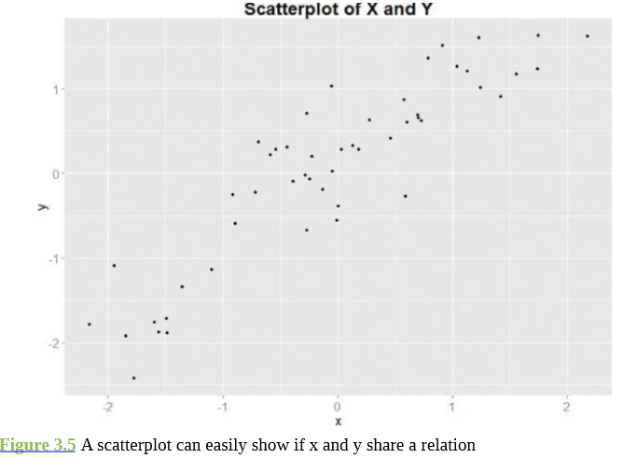

Slide 62
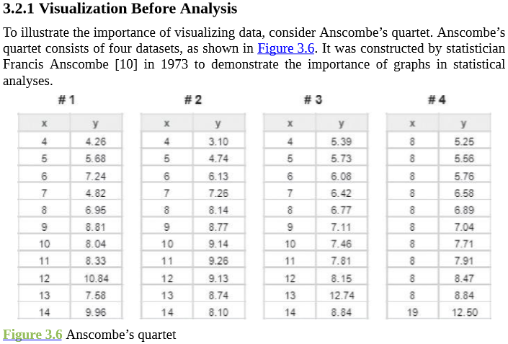

Slide 63
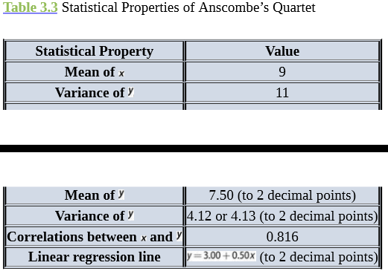

Slide 64
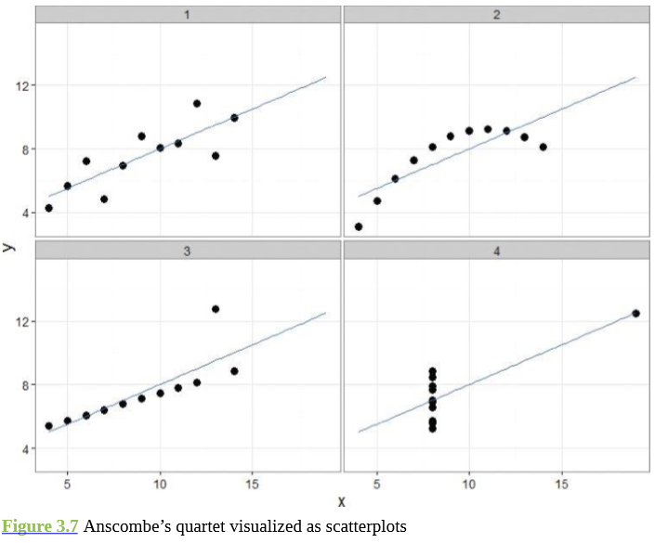

Slide 65
Enter data() for a list of datasets included in the R base distribution.
Enter data(DatasetName) to make a dataset available in the current workspace.

Slide 66
install.packages(“ggplot2”)
#not required if package has been installed
data(anscombe)
# load the anscombe dataset into the current workspace anscombe
x1 x2 x3 x4 y1 y2 y3 y4
1 10 10 10 8 8.04 9.14 7.46 6.58
2 8 8 8 8 6.95 8.14 6.77 5.76
3 13 13 13 8 7.58 8.74 12.74 7.71
4 9 9 9 8 8.81 8.77 7.11 8.84
5 11 11 11 8 8.33 9.26 7.81 8.47
6 14 14 14 8 9.96 8.10 8.84 7.04
7 6 6 6 8 7.24 6.13 6.08 5.25
8 4 4 4 19 4.26 3.10 5.39 12.50
9 12 12 12 8 10.84 9.13 8.15 5.56
10 7 7 7 8 4.82 7.26 6.42 7.91
11 5 5 5 8 5.68 4.74 5.73 6.89

Slide 67
nrow(anscombe)
# number of rows
[1] 11
# generates levels to indicate which group each data point belongs to
levels <- gl(4, nrow(anscombe))
levels
[1] 1 1 1 1 1 1 1 1 1 1 1 2 2 2 2 2 2 2 2 2 2 2 3 3 3 3 3 3 3 3 3 3 3
[34] 4 4 4 4 4 4 4 4 4 4 4
Levels: 1 2 3 4
# Group anscombe into a data frame
mydata <- with(anscombe, data.frame(x=c(x1,x2,x3,x4), y=c(y1,y2,y3,y4), mygroup=levels))

Slide 68
mydata
x y mygroup
10 8.04 1
8 6.95 1
13 7.58 1
9 8.81 1
…
41 19 12.50 4
8 5.56 4
8 7.91 4
8 6.89 4
# Make scatterplots using the ggplot2 package
library(ggplot2)
theme_set(theme_bw())
# set plot color theme
# create the four plots of Figure 3.7 ggplot(mydata, aes(x,y)) + geom_point(size=4) + geom_smooth(method=“lm”, fill=NA, fullrange=TRUE) + facet_wrap(˜mygroup)

Slide 69
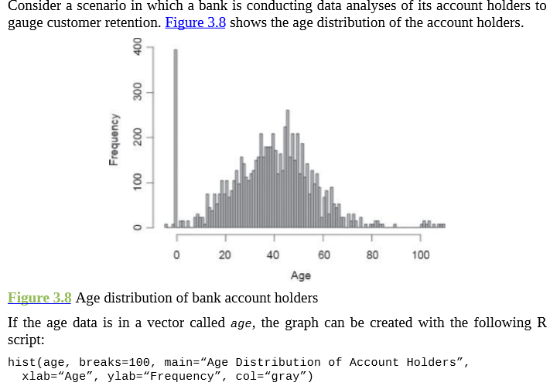
Dirty Data
Missing data that could have been replaced by 0 or negative values.
data cleansing needs to be performed over the accounts with abnormal age values.

Slide 70
x <- c(1, 2, 3, NA, 4)
is.na(x) # returns TRUE at each NA value and FALSE otherwise
[1] FALSE FALSE FALSE TRUE FALSE
Some arithmetic functions, such as mean(), applied to data containing missing values can yield an NA result.
To prevent this, set the na.rm parameter to TRUE to remove the missing value during the function’s execution.
mean(x)
[1] NA
mean(x, na.rm=TRUE)
[1] 2.5

Slide 71
The na.exclude() function returns the object with incomplete cases removed.
DF <- data.frame(x = c(1, 2, 3), y = c(10, 20, NA))
DF
x y
1 10
2 20
3 NA
DF1 <- na.exclude(DF)
DF1
x y
1 10
2 20

Slide 72
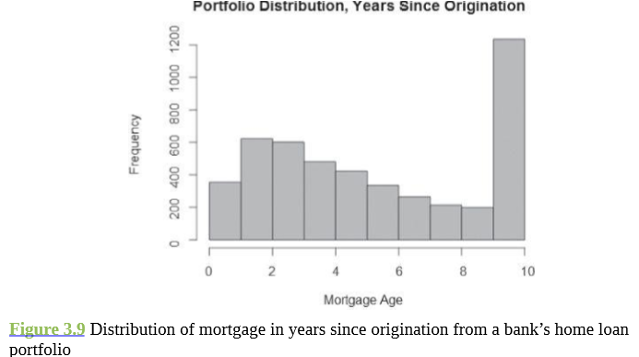
Abnormally large value.
May be >=10 and not only =10.
Due to system error

Slide 73
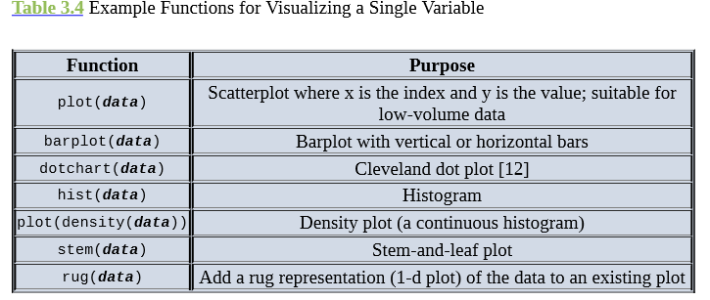
Visualizing a Single Variable

Slide 74
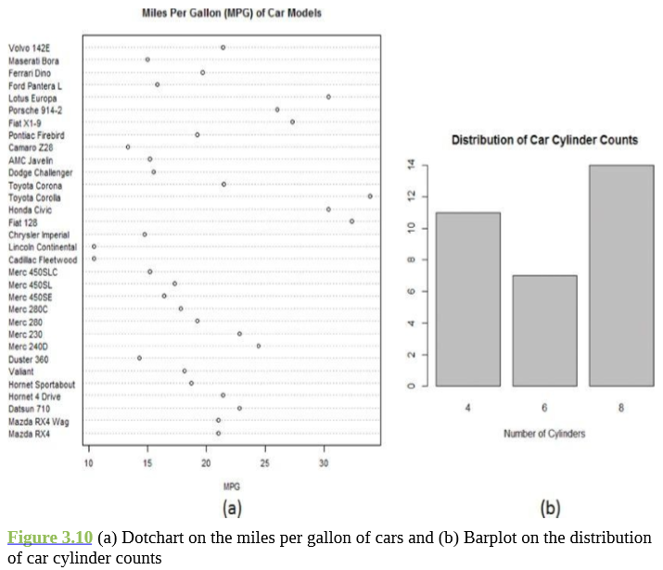

Slide 75
data(mtcars) dotchart(mtcars$mpg,labels=row.names(mtcars),cex=.7, main=“Miles Per Gallon (MPG) of Car Models”, xlab=“MPG”) barplot(table(mtcars$cyl), main=“Distribution of Car Cylinder Counts”, xlab=“Number of Cylinders”)

Slide 76
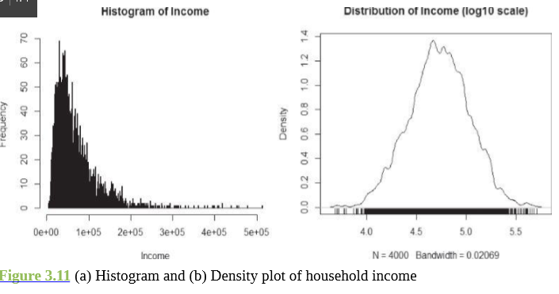
Histogram and Density Plot

Slide 77
# randomly generate 4000 observations from the log normal distribution
income <- rlnorm(4000, meanlog = 4, sdlog = 0.7)
summary(income)
Min. 1st Qu. Median Mean 3rd Qu. Max.
4.301 33.720 54.970 70.320 88.800 659.800
income <- 1000*income
summary(income)
Min. 1st Qu. Median Mean 3rd Qu. Max.
33720 54970 70320 88800 659800
# plot the histogram
hist(income, breaks=500, xlab=“Income”, main=“Histogram of Income”)
# density plot
plot(density(log10(income), adjust=0.5), main=“Distribution of Income (log10 scale)”)
# add rug to the density plot
rug(log10(income))

Slide 78
library(“ggplot2”)
data(diamonds)
# load the diamonds dataset from ggplot2
# Only keep the premium and ideal cuts of diamonds
niceDiamonds <- diamonds[diamonds$cut==“Premium” | diamonds$cut==“Ideal”,]
summary(niceDiamonds$cut)
Fair Good Very Good Premium Ideal
0 0 0 13791 21551
# plot density plot of diamond prices ggplot(niceDiamonds, aes(x=price, fill=cut)) + geom_density(alpha = .3, color=NA)
# plot density plot of the log10 of diamond prices
ggplot(niceDiamonds, aes(x=log10(price), fill=cut)) + geom_density(alpha = .3, color=NA)
As an alternative to ggplot2, the lattice package provides a function called densityplot() for making simple density plots

Slide 79
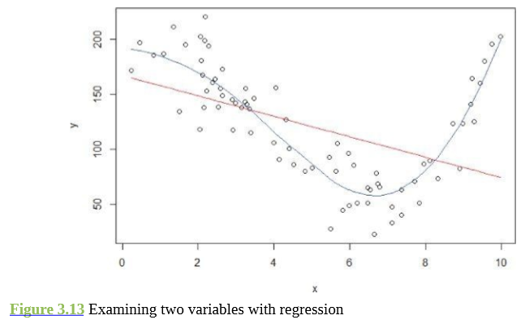
Examining Multiple Variable

Slide 80
# 75 numbers between 0 and 10 of uniform distribution
x <- runif(75, 0, 10)
x <- sort(x)
y <- 200 + x^3 - 10 * x^2 + x + rnorm(75, 0, 20)
lr <- lm(y ˜ x) # linear regression
poly <- loess(y ˜ x) # LOESS
fit <- predict(poly) # fit a nonlinear line
plot(x,y)
# draw the fitted line for the linear regression
points(x, lr$coefficients[1] + lr$coefficients[2] * x, type = “l”, col = 2)
# draw the fitted line with LOESS
points(x, fit, type = “l”, col = 4)

Slide 81
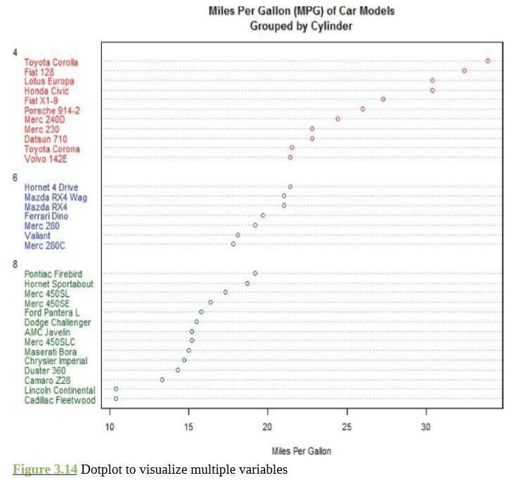
Dotchart and Barplot

Slide 82
# sort by mpg
cars <- mtcars[order(mtcars$mpg),]
# grouping variable must be a factor
cars$cyl <- factor(cars$cyl) cars$color[cars$cyl==4] <- “red” cars$color[cars$cyl==6] <- “blue” cars$color[cars$cyl==8] <- “darkgreen” dotchart(cars$mpg, labels=row.names(cars), cex=.7, groups= cars$cyl, main=“Miles Per Gallon (MPG) of Car Models\nGrouped by Cylinder”, xlab=“Miles Per Gallon”, color=cars$color, gcolor=“black”)

Slide 83
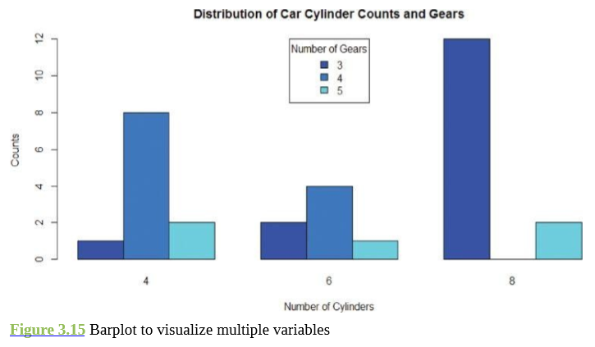

Slide 84
counts <- table(mtcars$gear, mtcars$cyl)
barplot(counts, main=“Distribution of Car Cylinder Counts and Gears”, xlab=“Number of Cylinders”, ylab=“Counts”, col=c(“#0000FFFF”, “#0080FFFF”, “#00FFFFFF”), legend = rownames(counts), beside=TRUE, args.legend = list(x=“top”, title = “Number of Gears”)

Slide 85
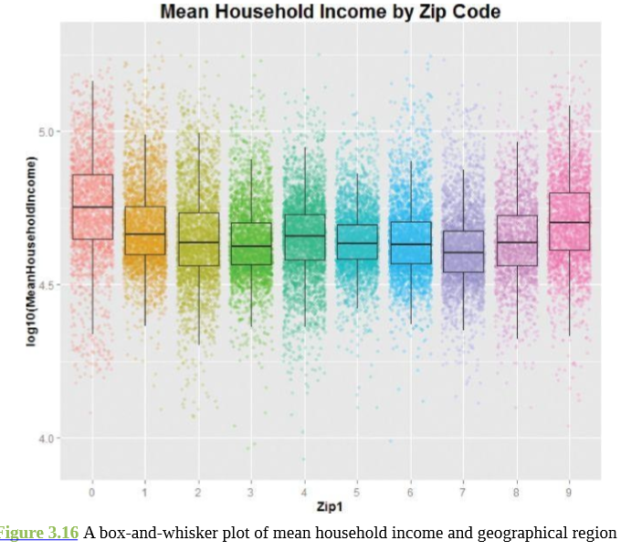
Box-and-Whisker Plot

Slide 86
library(ggplot2)
# plot the jittered scatterplot w boxplot
# color-code points with zip codes
# the outlier.size=0 prevents the boxplot from plotting the outlier ggplot(data=DF, aes(x=as.factor(Zip1), y=log10(MeanHouseholdIncome))) + geom_point(aes(color=factor(Zip1)), alpha=0.2, position=“jitter”) + geom_boxplot(outlier.size=0, alpha=0.1) + guides(colour=FALSE) + ggtitle (“Mean Household Income by Zip Code”)
Alternatively, one can create a simple box-and-whisker plot with the boxplot() function provided by the R base package.

Slide 87
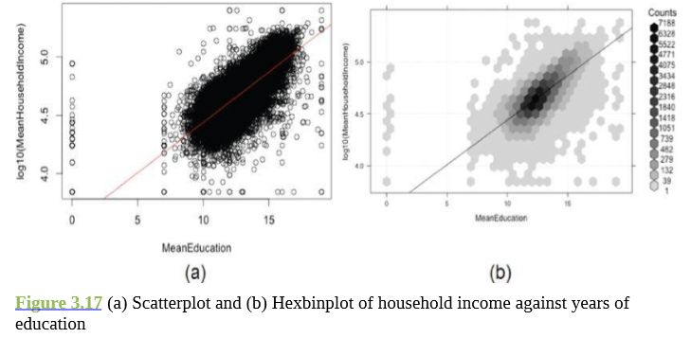
Hexbinplot for Large Dataset

Slide 88
# plot the data points plot(log10(MeanHouseholdIncome) ˜ MeanEducation, data=zcta)
# add a straight fitted line of the linear regression abline(lm(log10(MeanHouseholdIncome) ˜ MeanEducation, data=zcta), col=‘red’)

Slide 89
library(hexbin)
# “g” adds the grid, “r” adds the regression line
# sqrt transform on the count gives more dynamic range to the shading
# inv provides the inverse transformation function of trans hexbinplot(log10(MeanHouseholdIncome) ˜ MeanEducation, data=zcta, trans = sqrt, inv = function(x) x^2, type=c(“g”, “r”))

Slide 90
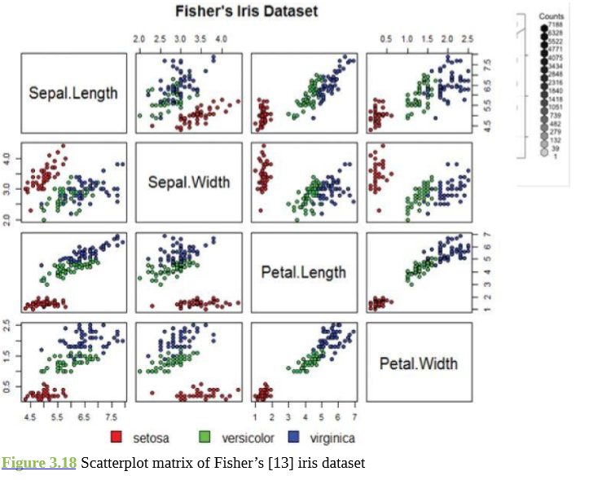
Scatterplot Matrix

Slide 91
# define the colors
colors <- c(“red”, “green”, “blue”)
# draw the plot matrix
pairs(iris[1:4], main = “Fisher’s Iris Dataset”, pch = 21, bg = colors[unclass(iris$Species)] )
# set graphical parameter to clip plotting to the figure region
par(xpd = TRUE)
# add legend
legend(0.2, 0.02, horiz = TRUE, as.vector(unique(iris$Species)), fill = colors, bty = “n”)
The vector colors defines the color scheme for the plot. It could be changed to something like colors <- c(“gray50”, “white”, “black”) to make the scatterplots grayscale.

Slide 92
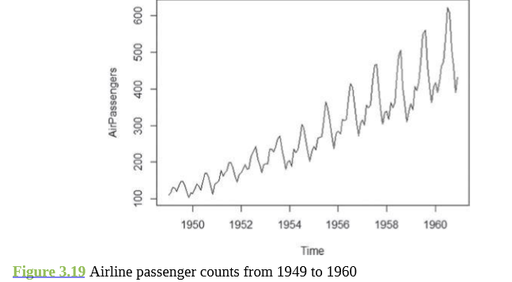
Analyzing a Variable over Time
The plot shows that, for each year, a large peak occurs mid-year around July and August, and a small peak happens around the end of the year, possibly due to the holidays.
Such a phenomenon is referred to as a seasonality effect.

Slide 93
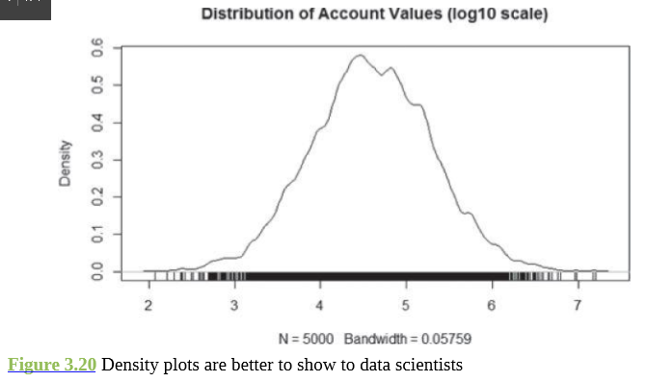
Data Exploration Versus Presentation

Slide 94
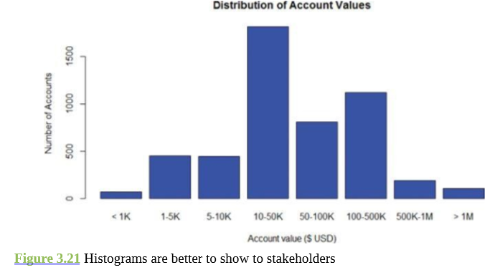

Slide 95
# Generate random log normal income data
income = rlnorm(5000, meanlog=log(40000), sdlog=log(5))
# Part I: Create the density plot plot(density(log10(income), adjust=0.5), main=“Distribution of Account Values (log10 scale)”)
# Add rug to the density plot
rug(log10(income))
# Part II: Make the histogram
# Create “log-like bins”
breaks = c(0, 1000, 5000, 10000, 50000, 100000, 5e5, 1e6, 2e7)
# Create bins and label the data
Bins = cut(income, breaks, include.lowest=T, labels = c(“< 1K”, “1-5K”, “5-10K”, “10-50K”, “50-100K”, “100-500K”, “500K-1M”, “> 1M”))
# Plot the bins
plot(bins, main = “Distribution of Account Values”, xlab = “Account value ($ USD)”, ylab = “Number of Accounts”, col=“blue”)

Slide 96
Hypothesis Testing
When comparing populations, such as testing or evaluating the difference of the means from two samples of data, a common technique to assess the difference or the significance of the difference is hypothesis testing.

Slide 97
The basic concept of hypothesis testing is to form an assertion and test it with data.
When performing hypothesis tests, the common assumption is that there is no difference between two samples.
This assumption is used as the default position for building the test or conducting a scientific experiment.
Statisticians refer to this as the null hypothesis ( ).
The alternative hypothesis ( ) is that there is a difference between two samples. For example, if the task is to identify the effect of drug A compared to drug B on patients, the null hypothesis and alternative hypothesis would be this.

Slide 98
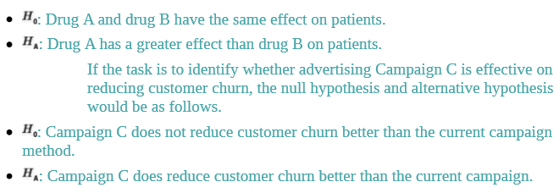

Slide 99
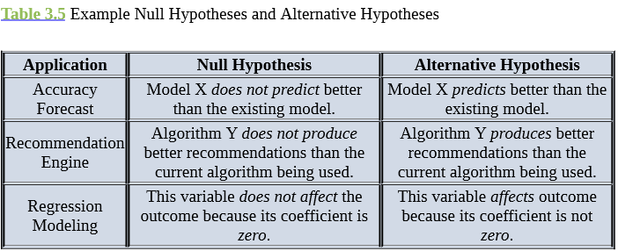

Slide 100
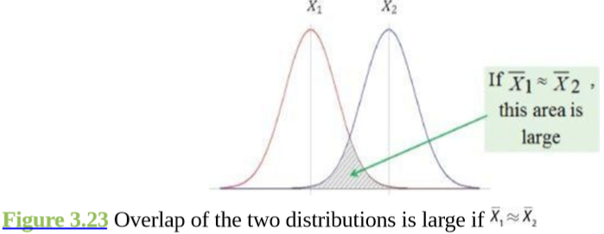
Difference of means

Slide 101
Student’s t-test
Student’s t-test assumes that distributions of the two populations have equal but unknown variances.
Suppose n1 and n2 samples are randomly and independently selected from two populations, pop1 and pop2, respectively.
If each population is normally distributed with the same mean ( mu1=mu2) and with the same variance, then T (the t-statistic), given in Equation 3.1, follows a t-distribution with n1+n2-2 degrees of freedom (df).

Slide 102
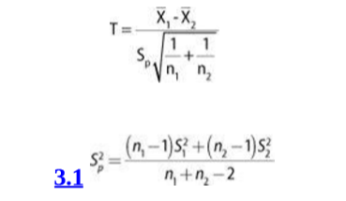

Slide 103
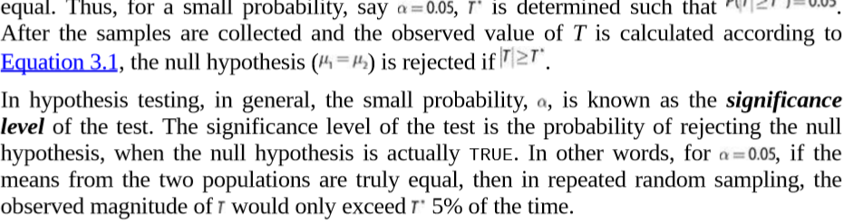

Slide 104
Difference of Means
# generate random observations from the two populations
x <- rnorm(10, mean=100, sd=5)
# normal distribution centered at 100
y <- rnorm(20, mean=105, sd=5)
# normal distribution centered at 105
t.test(x, y, var.equal=TRUE)
# run the Student’s t-test
Two Sample t-test
data: x and y
t = -1.7828, df = 28, p-value = 0.08547
alternative hypothesis: true difference in means is not equal to 0
95 percent confidence interval:
-6.1611557 0.4271893
sample estimates:
mean of x mean of y
102.2136 105.0806

Slide 105
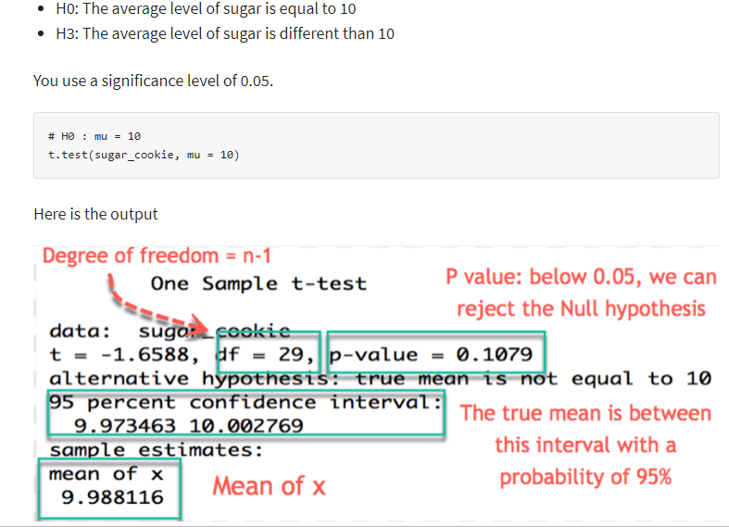

Slide 106
Because the alternative hypothesis is that the means are not equal (mu1 not equal to mu2 ), the possibilities of both mu1>mu2 and mu1<mu2 need to be considered.
This form of Student’s t-test is known as a two-sided hypothesis test, and it is necessary for the sum of the probabilities under both tails of the t- distribution to equal the significance level.

Slide 107
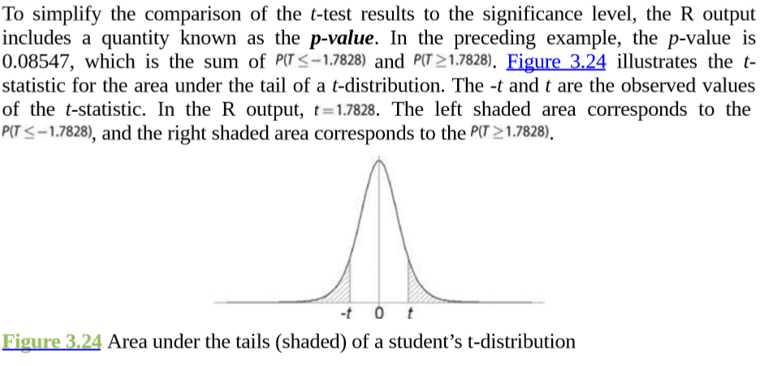

Slide 108
However, based on the p-value, if the significance level was chosen to be 0.10, instead of 0.05, the null hypothesis would be rejected.
A key assumption in using Student’s t-test is that the population variances are equal. In the previous example, the t.test() function call includes var.equal=TRUE to specify that equality of the variances should be assumed.
If that assumption is not appropriate, then Welch’s t-test should be used.

Slide 109
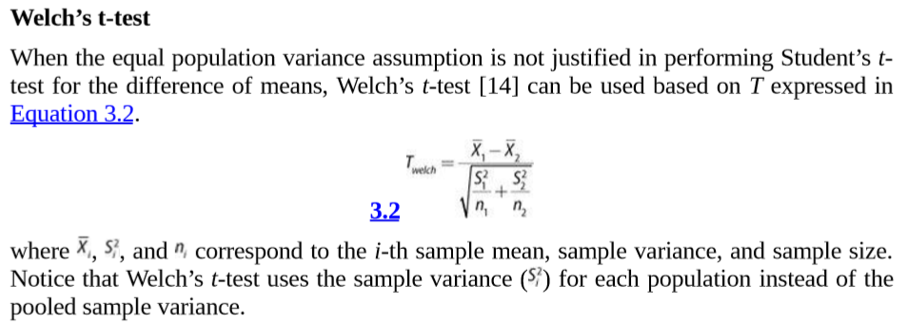
Welch’s t-test

Slide 110
t.test(x, y, var.equal=FALSE)
# run the Welch’s t-test Welch
Two Sample t-test
data: x and y
t = -1.6596, df = 15.118, p-value = 0.1176
alternative hypothesis: true difference in means is not equal to 0
percent confidence interval:
-6.546629 0.812663
sample estimates:
mean of x mean of y
102.2136 105.0806

Slide 111
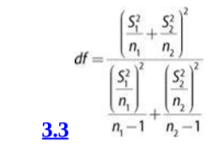
The degrees of freedom for Welch’s t-test is defined in Equation 3.3.

Slide 112
A confidence interval is an interval estimate of a population parameter or characteristic based on sample data.
A key assumption in both the Student’s and Welch’s t-test is that the relevant population attribute is normally distributed.
For non-normally distributed data, it is sometimes possible to transform the collected data to approximate a normal distribution.
For example, taking the logarithm of a dataset can often transform skewed data to a dataset that is at least symmetric around its mean.
However, if such transformations are ineffective, there are tests like the Wilcoxon rank-sum test that can be applied to see if two population distributions are different.

Slide 113
Wilcoxon Rank-Sum Test
Wilcoxon Rank-Sum Test is a nonparametric hypothesis test that checks whether two populations are identically distributed
The first step of the Wilcoxon test is to rank the set of observations from the two groups as if they came from one large group.
The smallest observation receives a rank of 1, the second smallest observation receives a rank of 2, and so on with the largest observation being assigned the rank of N.
Ties among the observations receive a rank equal to the average of the ranks they span.
The test uses ranks instead of numerical outcomes to avoid specific assumptions about the shape of the distribution.
After ranking all the observations, the assigned ranks are summed for at least one population’s sample.
If the distribution of pop1 is shifted to the right of the other distribution, the rank-sum corresponding to pop1‘s sample should be larger than the rank- sum of pop2.
The Wilcoxon rank-sum test determines the significance of the observed rank-sums.

Slide 114
Wilcoxon Rank-Sum Test
wilcox.test(x, y, conf.int = TRUE) Wilcoxon rank sum
test data: x and y
W = 55, p-value = 0.04903 alternative hypothesis: true location shift is not equal to 0
95 percent confidence interval:
-6.2596774 -0.1240618
sample estimates: difference in location -3.417658
Because the Wilcoxon test does not assume anything about the population distribution, it is generally considered more robust than the t-test.

Slide 115
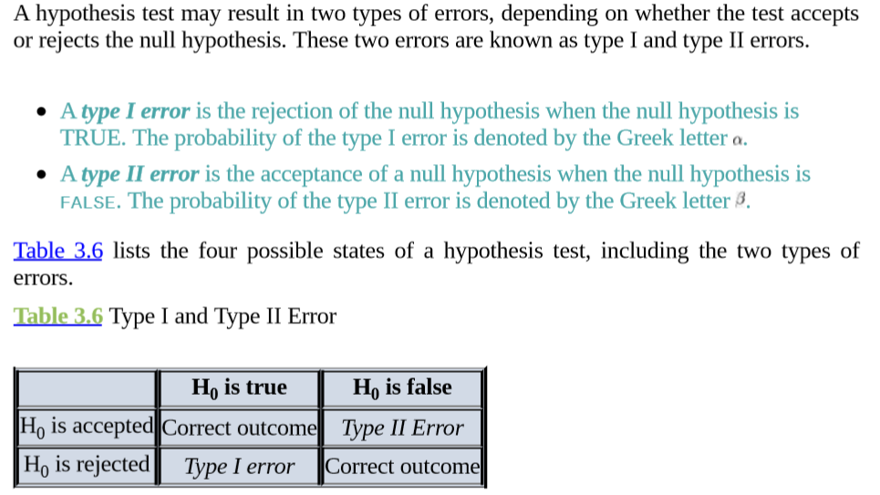
Type I and Type II Errors

Slide 116
The significance level, as mentioned in the Student’s t-test discussion, is equivalent to the type I error.
For a significance level =0.05, if the null hypothesis (mu1=mu2 ) is TRUE, there is a 5% chance that the observed T value based on the sample data will be large enough to reject the null hypothesis.
By selecting an appropriate significance level, the probability of committing a type I error can be defined before any data is collected or analyzed.
The probability of committing a Type II error is somewhat more difficult to determine.
If two population means are truly not equal, the probability of committing a type II error will depend on how far apart the means truly are.
To reduce the probability of a type II error to a reasonable level, it is often necessary to increase the sample size.

Slide 117
The power of a test is the probability of correctly rejecting the null hypothesis.
It is denoted by (1-beta), where beta is the probability of a type II error.
Because the power of a test improves as the sample size increases, power is used to determine the necessary sample size.
In the difference of means, the power of a hypothesis test depends on the true difference of the population means.
In other words, for a fixed significance level, a larger sample size is required to detect a smaller difference in the means.
In general, the magnitude of the difference is known as the effect size.
As the sample size becomes larger, it is easier to detect a given effect size

Slide 118
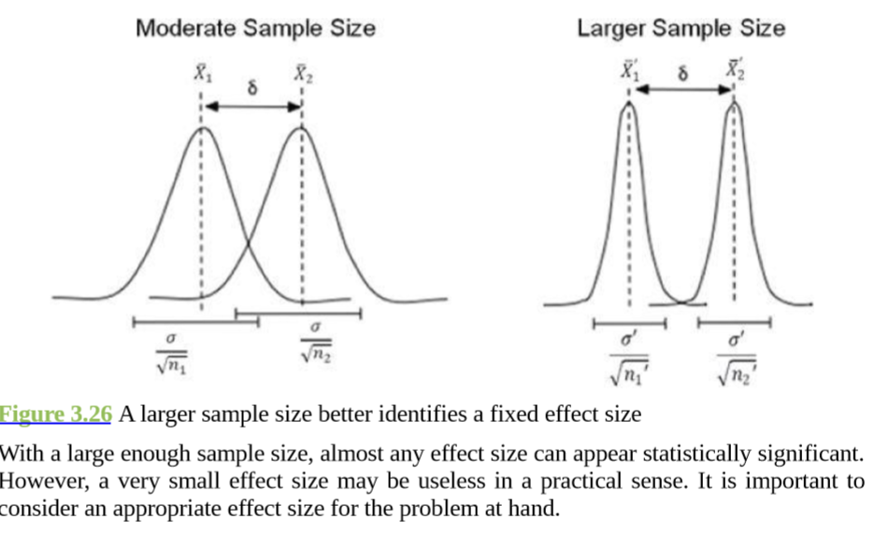

Slide 119
Anova
The hypothesis tests presented in the previous sections are good for analyzing means between two populations.
But what if there are more than two populations? Consider an example of testing the impact of nutrition and exercise on 60 candidates between age 18 and 50. The candidates are randomly split into six groups, each assigned with a different weight loss strategy, and the goal is to determine which strategy is the most effective.
Group 1 only eats junk food.
Group 2 only eats healthy food.
Group 3 eats junk food and does cardio exercise every other day.
Group 4 eats healthy food and does cardio exercise every other day.
Group 5 eats junk food and does both cardio and strength training every other day.
Group 6 eats healthy food and does both cardio and strength training every other day.

Slide 120
Multiple t-tests could be applied to each pair of weight loss strategies. In this example, the weight loss of Group 1 is compared with the weight loss of Group 2, 3, 4, 5, or 6.
Similarly, the weight loss of Group 2 is compared with that of the next 4 groups. Therefore, a total of 15 t-tests would be performed.
However, multiple t-tests may not perform well on several populations for two reasons.
First, because the number of t-tests increases as the number of groups increases, analysis using the multiple t-tests becomes cognitively more difficult.
Second, by doing a greater number of analyses, the probability of committing at least one type I error somewhere in the analysis greatly increases.
Analysis of Variance (ANOVA) is designed to address these issues.
ANOVA is a generalization of the hypothesis testing of the difference of two population means.
ANOVA tests if any of the population means differ from the other population means.
The null hypothesis of ANOVA is that all the population means are equal.
The alternative hypothesis is that at least one pair of the population means is not equal. In other words

Slide 121
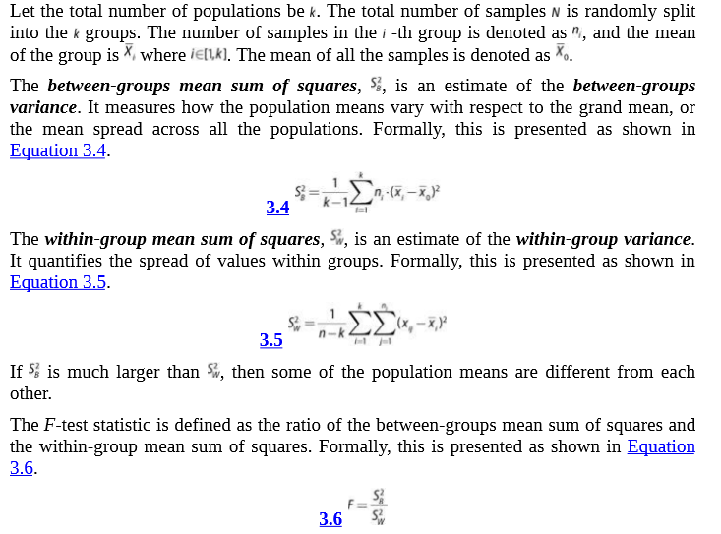

Slide 122
The F-test statistic in ANOVA can be thought of as a measure of how different the means are relative to the variability within each group.
The larger the observed F-test statistic, the greater the likelihood that the differences between the means are due to something other than chance alone.
The F-test statistic is used to test the hypothesis that the observed effects are not due to chance—that is, if the means are significantly different from one another.
Consider an example that every customer who visits a retail website gets one of two promotional offers or gets no promotion at all.
The goal is to see if making the promotional offers makes a difference.
ANOVA could be used, and the null hypothesis is that neither promotion makes a difference.

Slide 123
offers <- sample(c(“offer1”, “offer2”, “nopromo”), size=500, replace=T)
# Simulated 500 observations of purchase sizes on the 3 offer options
purchasesize <- ifelse(offers==“offer1”, rnorm(500, mean=80, sd=30), ifelse(offers==“offer2”, rnorm(500, mean=85, sd=30), rnorm(500, mean=40, sd=30)))
# create a data frame of offer option and purchase size
offertest <- data.frame(offer=as.factor(offers), purchase_amt=purchasesize)
bla
# display a summary of offertest where offer=“offer1” summary(offertest[offertest$offer==“offer1”,])
offer purchase_amt
nopromo: 0 Min. : 4.521
offer1 :170 1st Qu.: 58.158
offer2 : 0 Median : 76.944
Mean : 81.936
3rd Qu.:104.959
Max. :180.507

Slide 124
bla
# display a summary of offertest where offer=“offer2”
summary(offertest[offertest$offer==“offer2”,])
offer purchase_amt
nopromo: 0 Min. : 14.04
offer1 : 0 1st Qu.: 69.46
offer2 :161 Median : 90.20
Mean : 89.09
3rd Qu.:107.48
Max. :154.33
bla
# display a summary of offertest where offer=“nopromo”
summary(offertest[offertest$offer==“nopromo”,])
offer purchase_amt
nopromo:169 Min. :-27.00
offer1 : 0 1st Qu.: 20.22
offer2 : 0 Median : 42.44
Mean : 40.97
3rd Qu.: 58.96
Max. :164.04

Slide 125
The aov() function performs the ANOVA on purchase size and offer options.
bla
# fit ANOVA
test model <- aov(purchase_amt ˜ offers, data=offertest)
summary(model)
Df Sum Sq Mean Sq F value Pr(>F)
offers 2 225222 112611 130.6 <2e-16 ***
Residuals 497 428470 862
–
Signif. codes: 0 ‘***’ 0.001 ‘**’ 0.01 ‘*’ 0.05 ‘.’ 0.1 ‘ ‘ 1

Slide 126
The output also includes the (112,611), (862), the F-test statistic (130.6), and the p- value (< 2e–16).
The F-test statistic is much greater than 1 with a p-value much less than 1. Thus, the null hypothesis that the means are equal should be rejected.
However, the result does not show whether offer1 is different from offer2, which requires additional tests.
The TukeyHSD() function implements Tukey’s Honest Significant Difference (HSD) on all pair-wise tests for difference of means.
TukeyHSD(model)
Tukey multiple comparisons of means
95% family-wise confidence level
Fit: aov(formula = purchase_amt ˜ offers, data = offertest)
$offers diff lwr upr p adj
offer1-nopromo 40.961437 33.4638483 48.45903 0.0000000
offer2-nopromo 48.120286 40.5189446 55.72163 0.0000000
offer2-offer1 7.158849 -0.4315769 14.74928 0.0692895

Slide 127
The result includes p-values of pair-wise comparisons of the three offer options.
The p- values for offer1-nopromo and offer-nopromo are equal to 0, smaller than the significance level 0.05.
This suggests that both offer1 and offer2 are significantly different from nopromo.
A p-value of 0.0692895 for offer2 against offer1 is greater than the significance level 0.05.
This suggests that offer2 is not significantly different from offer1.
Because only the influence of one factor (offers) was executed, the presented ANOVA is known as one-way ANOVA.
If the goal is to analyze two factors, such as offers and day of week, that would be a two-way ANOVA [16].
If the goal is to model more than one outcome variable, then multivariate ANOVA (or MANOVA) could be used.

